Slide 1
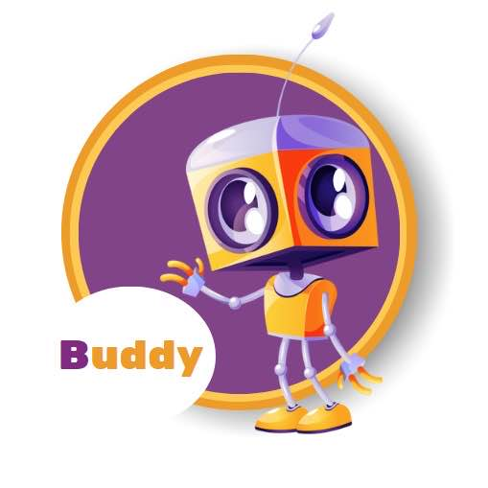

Hero Buddy AI-Powered SEL Chatbot

Slide 2
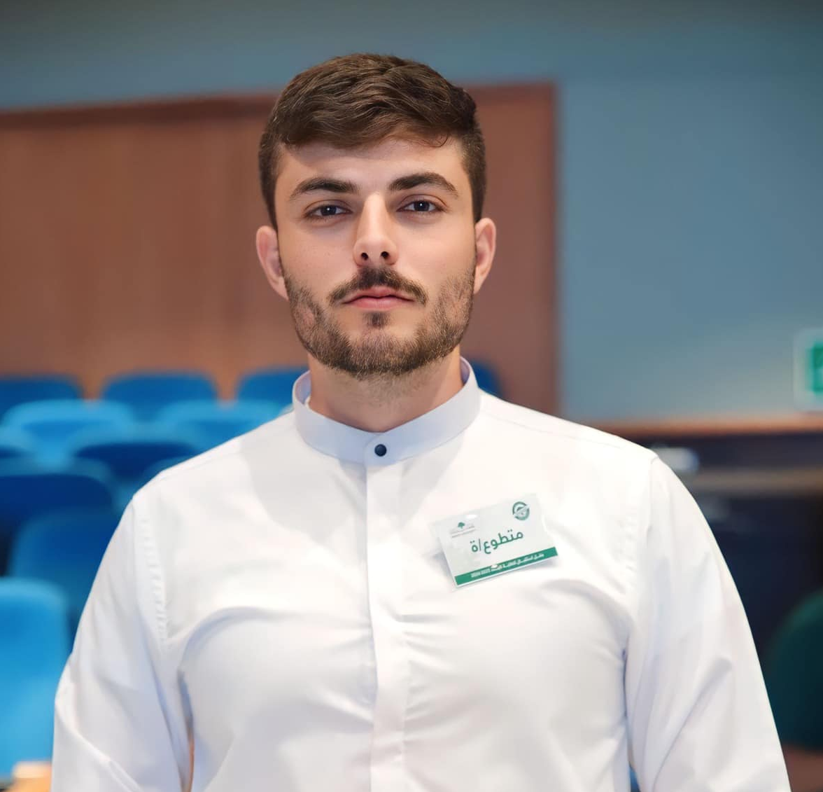


Who Are We?
Qutaiba Olayyan
Aseel Sabri
Christoforos Seas

Slide 3
Heroes Made Ltd. - Empowering Young Heroes
Empowering Social-Emotional Learning (SEL) in Elementary Schools
Zero-prep, user-friendly platform for teachers
Customizable, immersive storybooks for students
Encourages uniqueness and embraces diversity by utilizing student avatars.

Slide 4
Current Limitations
Need for assistant outside school-hours
Help students identifying and managing their emotions at any time

Slide 5
Hero Buddy
Social and Emotional Support and Guidance
SEL Competencies Incorporation
COPPA Compliance

Slide 6
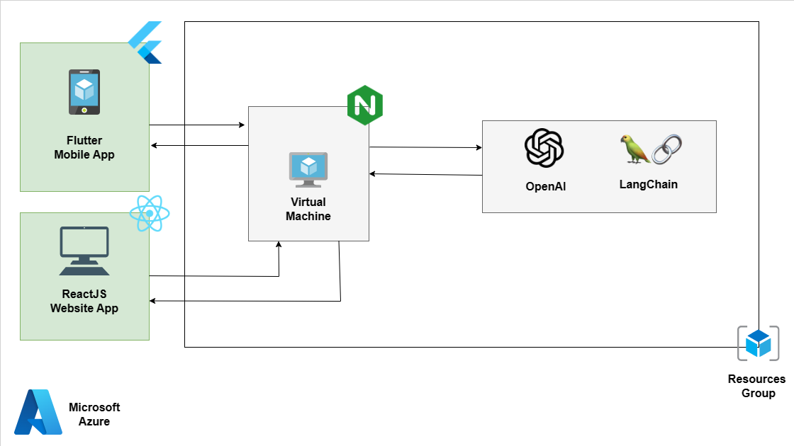
Architecture Design

Slide 7
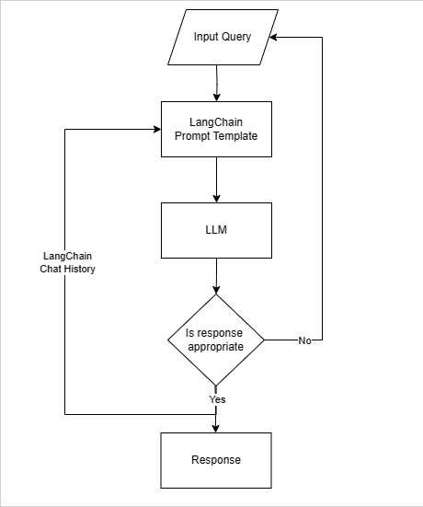
Chatbot Flow

Slide 8

Mobile Application
Our client needs this chatbot to be a mobile (Android / iOS) application.
Flutter generates an app that can run on:
Android,
iOS,
Linux,
macOS,
windows,
web.
Needless to say, we decided to continue with Flutter.

Slide 9
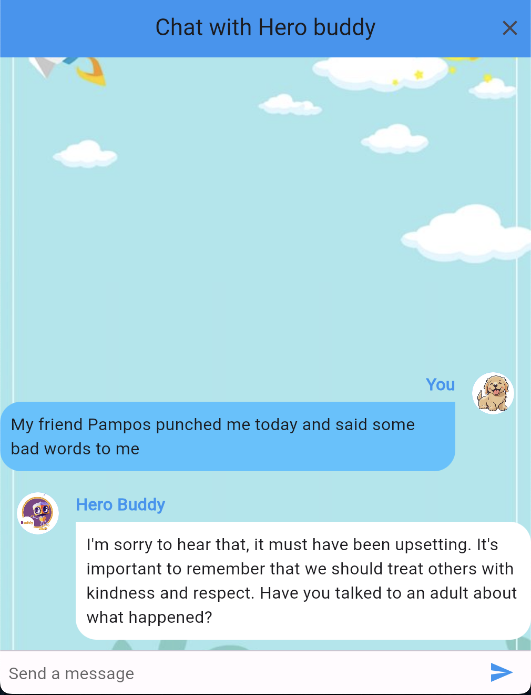


Frontend - Backend communication
API request: <url>/api/chat
body:
{
question: “My friend Pampos punched me today and said some bad words to me”
}
Using Azure’s AI Studio with Chat GPT 3.5 turbo
API Backend

Slide 10
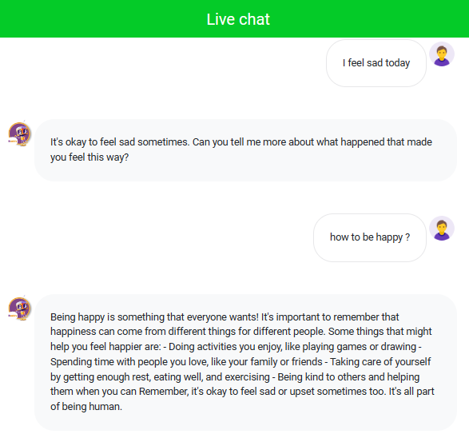

Website Application

Slide 11
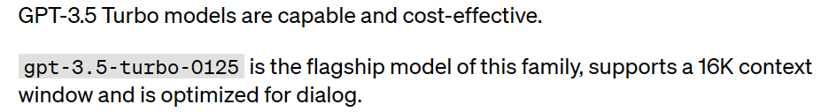
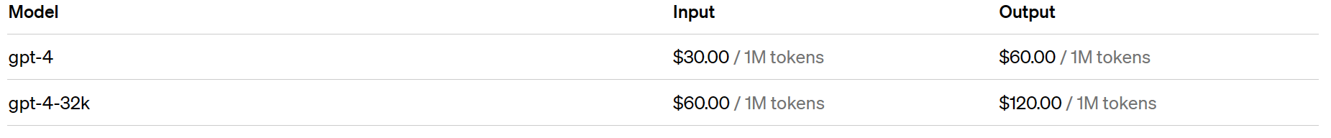
LLM Models

Slide 12

Future Work
Leveraging Voice Analysis for Emotion Recognition

Slide 13
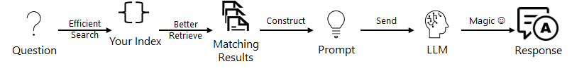
Future Work
Retrieval augmented generation and indexes

Slide 14

Future Work
Azure Cosmos DB for MongoDB

Slide 15
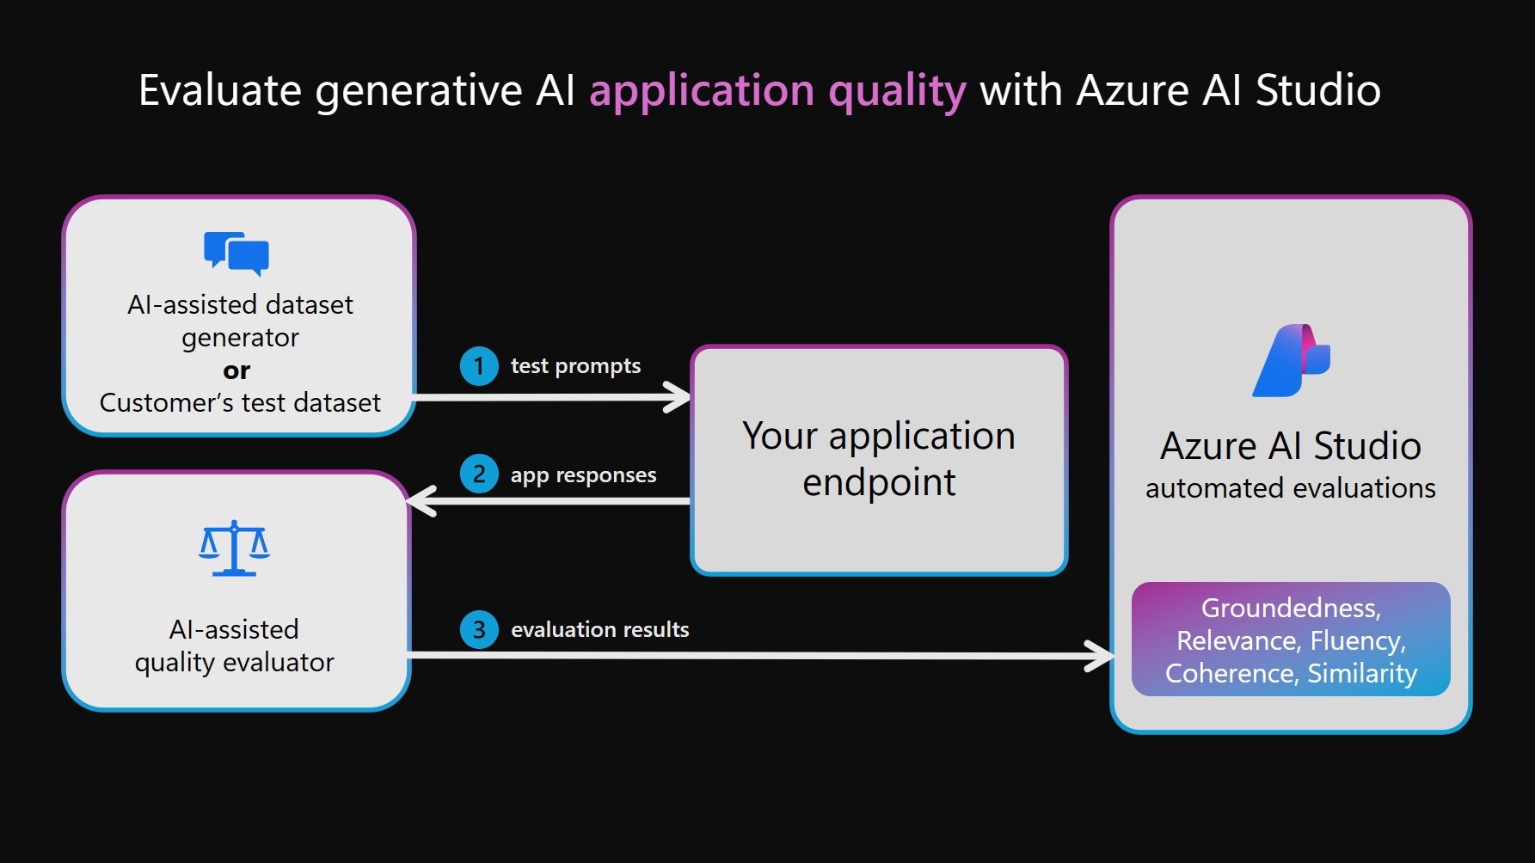
Future Work
Evaluate generative AI application quality
With Azure AI Studio

Slide 16


